Slide 1
Multi-Threading
OOp345-week 10

Slide 2
Background
With the invention of multi-cored processors, there was a need to move away from JUST sequential programming (having a program run a command at a time)
Multi-threading was built to distribute data among different processors to allow work/computations to be shared.

Slide 3
Performance
Program performance is made up of
Tasks
Communications
Tasks: takes time to compute. A Task is a group of instructions (could be a program or function)
Communications: Takes time to complete. Communication transfers information to parts of the computer (processor, registry, memory, and storage)
The time it takes to communicate is called Latency.

Slide 4
Role of problem Size
Depending on your program’s problem size the amount of time it takes to complete increases.
The increase in time is not always the same for each problem.
A program has 2 complexities:
Time complexity: rate at which time grows compared to problem size
Space Complexity: rate at which Memory is used compared to problem size
Usually we use one to solve another problem.
Ex. We can use more time but less memory, or use more memory to solve it quicker.

Slide 5
Processes and Threads
Multi-Tasking is different from multi-threading
A process is a piece of a program that is running on our system
A process takes control of your system but if it requires something it will be Halted
Once the process is finished it returns control
A thread is a sequence of instructions that your system can run independently
They exist in a process and are smaller versions of processes
They can run congruently with other threads and share the same address

Slide 6
Processes and Threads cont.
A thread can be a hardware or software thread
Software threads: managed by the OS (virtual)
Hardware threads: Managed by the Hardware cores (4 core, up to 4 threads)

Slide 7
Terms
Shared Memory: When writing a program, we expect the same results on each run through, however threads have access to the same memory and the results can vary if not programmed properly. Here are some things that can happen:
Race condition: two+ threads try to access the same place in memory at the same time. (real world example: Two people trying to write to the same line on google docs)
Deadlock: Two+ threads wait on the other for a resource and are therefore blocked forever. (R.W.E. two cars on a one lane road, waiting for the other to move)
Shared State: a state shared by two+ threads used for communications
Mutex: Mutex(mutual exclusion) locks a variable while writing to prevent access by other threads.
Atomics: allows for free-lock execution of instructions

Slide 8
STl working with threads
C++17 has some policies about threads: (types)
std::execution::sequenced_policy – has to be run in sequence(in order)
std::execution::parallel_policy – can be run in parallel
std::execution::parallel_unsequenced_policy – can be run parallel, vectorized or migrated across threads
Note: Vectorization (vectors) differ when talking about threads . When we talk about it in terms of threading it is referring to registers in memory.
Policy Objects:
std::execution::seq – sequential, single threaded
std::execution::par – parallel, multi threaded
std::execution::par_vec – Parallel + vector, multithreaded with vectorization

Slide 9
Stl algorithms that allow threading policies
See the section in the notes https://ict.senecacollege.ca/~oop345/pages/content/multi.html

Slide 10
Code example
// policies.cpp #include <iostream> #include <numeric> #include <vector> #include <execution> int main() { std::vector<double> x(10000000, 0.5); double s = std::reduce(std::execution::par, x.begin(), x.end()); std::cout << "sum = " << s << std::endl; } | //we need to include the execution library //in our reduce algorithm, we pass in the parallel policy object. This allows us to run this algorithm in parallel threads likely reducing the time significantly.

Slide 11
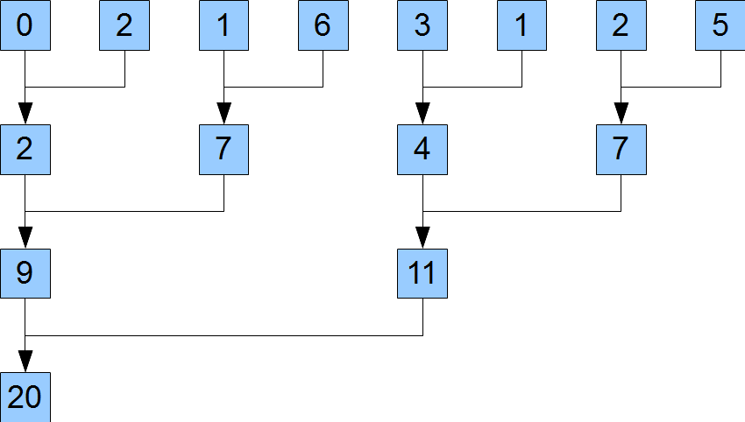
Reduction explained

Slide 12
Thread Classes
If we want to incorporate threads we need the thread library
#include <threads>
The thread class creates a thread. That thread is either joinable or not-joinable.
A Joinable thread is an actual thread of execution with a unique thread ID
A non-joinable object can have a potential thread of executions. (they are similar to a unassigned variable)

Slide 13
Threading Code
https://ict.senecacollege.ca/~oop345/pages/content/threa.html#thr

Slide 14
Future Library
Future objects exist in the future library
#include <future>
Future objects have a valid or not-valid state. These values are associated with a shared state of a spot/value in memory.
If the value is ready, future is valid.
If the value is not ready, the future is not-valid. Until it is ready, any retrieval will wait.
Let’s Look at some Code:
https://ict.senecacollege.ca/~oop345/pages/content/threa.html#fut

Slide 15
Thread Local storage
Variables in the thread have their own location in memory, for each thread.
Variables created in the thread, last the lifetime of the thread

